Slide 1
Luxury Handbag Price Prediction
Abinaya Manimaran
Ananya Singh
Deepika Kanade
EE 500 : Neural Learning and Computational Intelligence

Slide 2


Motivation
Oh Okay… Enjoy!
I’m Super excited!!!!
We are going Shopping!
Most women love shopping, especially handbags

Slide 3


Motivation
That was half of my grad school tuition fees : (
I got a Gucci handbag for $34000
I don’t even find the difference between two!!
I got one for $2000
Need for luxury handbag price prediction

Slide 4
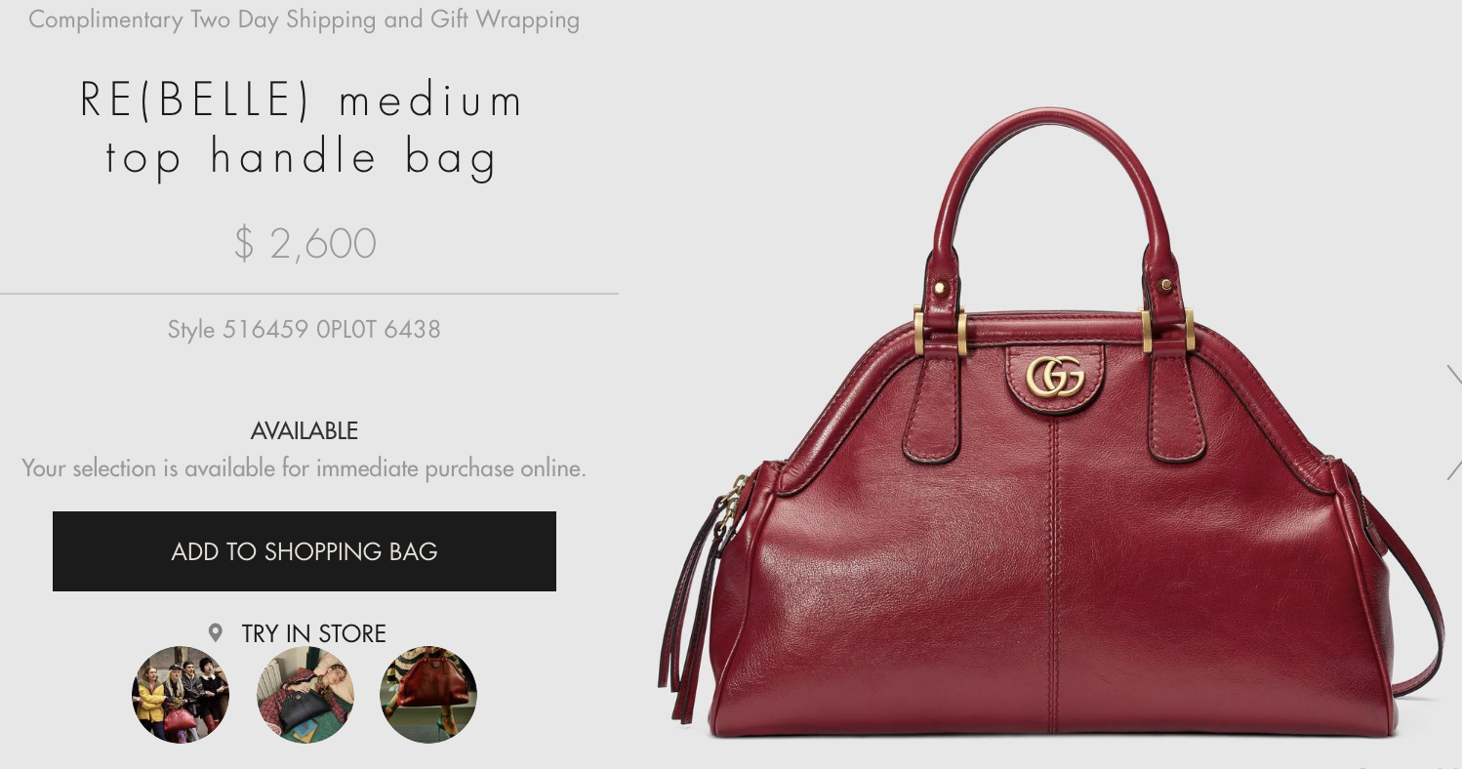
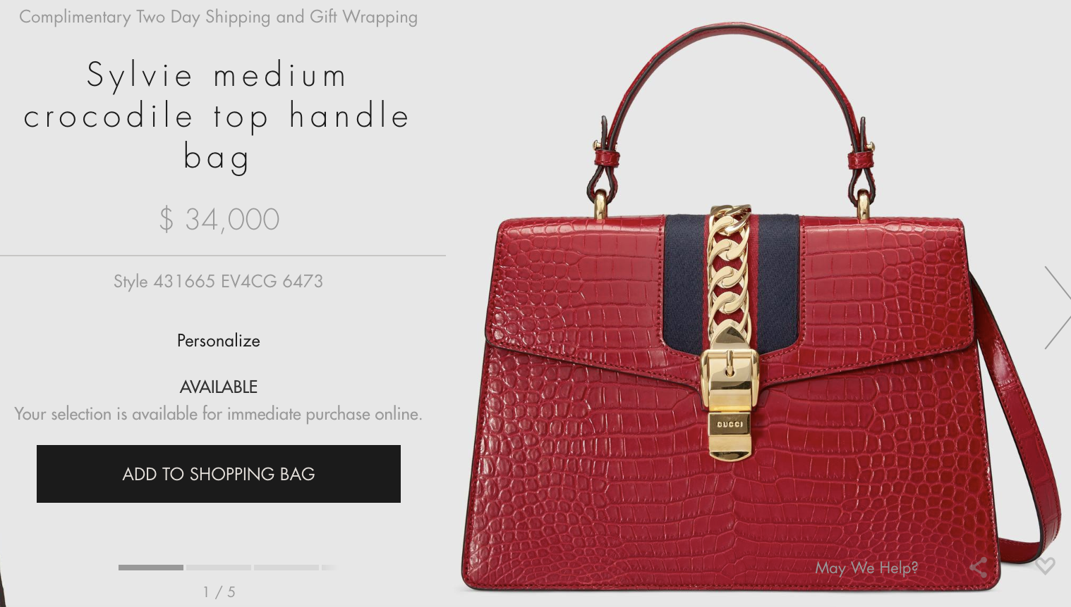
VARIATION IN BAG PRICES
$2,600 – calfskin
Gucci
$34,000 – Crocodile skin
Gucci
Skin Type is the most important feature

Slide 5
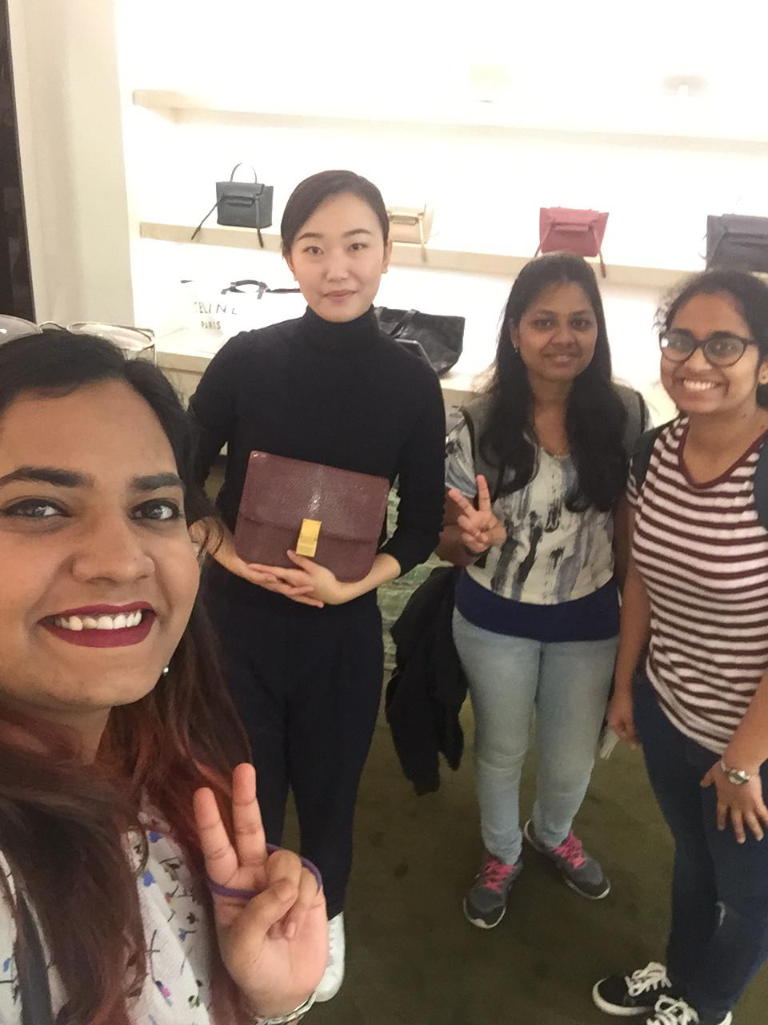
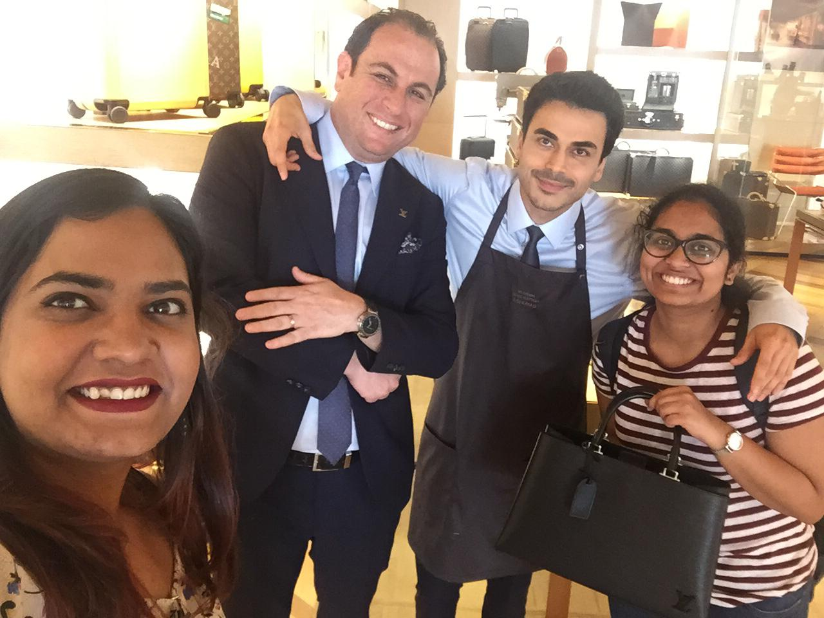
Talking to the experts
With the Louis Vuitton experts at
Beverly Hills Rodeo Drive
With the Celine expert at Neiman Marcus
9700 Wilshire Blvd, Beverly Hills
With the Tom Ford expert at
Beverly Hills Rodeo Drive
Notes:
Ananya

Slide 6
DATA COLLECTION
Brand | Hardware – Metal Type | Number of Components | Usage Type
Bag Name | Hardware – Number of zips | Major Color | Number of Functionality
Accessories | Hardware - Strap type | Number of Colors | Launch Season
Bag Style | Hardware – strap length | Height, Width, Breadth | Launch Year
Skin Type | Number of Compartments | Volume | Production Type
Inner Material | Place of Manufacture | Demand | Number of Hours
Skin Source | PRICE |  | Number of People
Total of 27 Features were determined
Notes:
Ananya

Slide 7
IMPORTANT FEATURE IDENTIFICATION
Based on Experts opinions
Number of Components
Brand
Single piece bag
Different components stitched together
Chanel
Gucci
Celine
Hermes
Louis Vuitton
Tom ford
Volume
Skin Type
Production
With the Gucci expert and a $34,000 bag
Crocodile, Alligator
Python, Snake
Lizard
Calf, Lamb
Hand stitched
Machine made
These five features are important for hand bag pricing
Notes:
Ananya

Slide 8
PRE-PROCESSING
Continuous features
- Number of zips
- Strap length
- Number of compartments
- Number of components
- Number of colors
- Volume
- Number of functionalities
Ordered Categorical features
Unordered Categorical features
- Metal type
- Strap type
- Inner material
- Brand
- Accessories
- Bag style
- Major color
- Skin Type
Total data points collected = 142
Train-Test Split (80/20) = 113/29

Slide 9
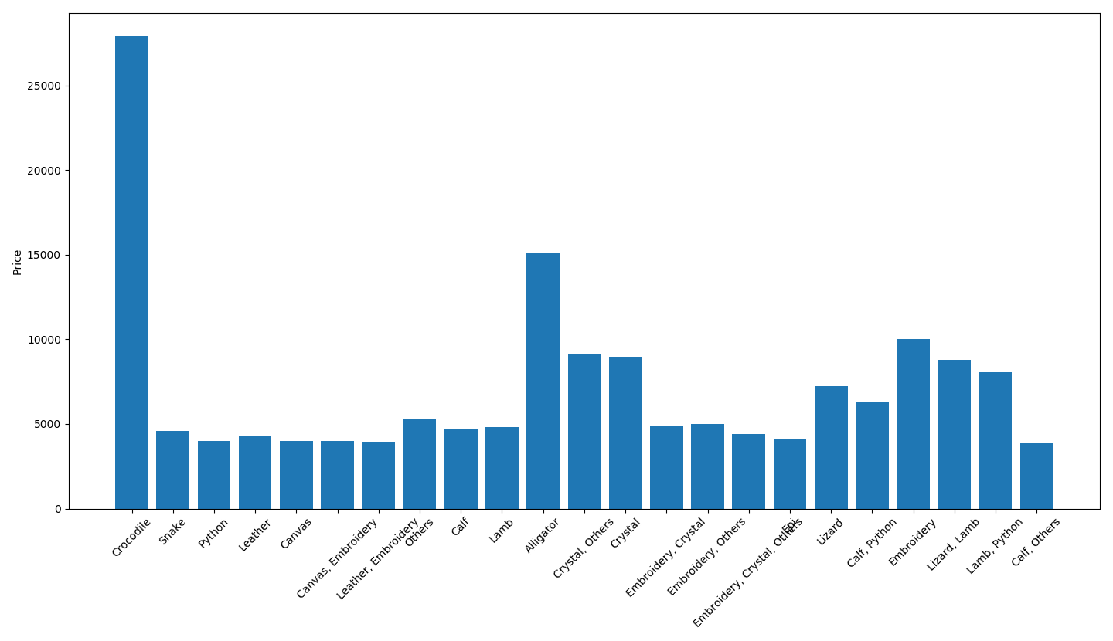
SKIN TYPE
Some skin types (Crocodile, Alligator) are costly

Slide 10
INTIAL MODEL - ALL FEATURES
MODEL | Test RMSE | TEST R^2 SCORE
Linear | 4248.90 | -0.367
Ridge(Alpha = 3) | 2231.86 | 0.477
Lasso(Alpha = 3) | 2578.71 | 0.316
SVR(kernel = Poly) | 3359.31 | -0.323
Overfitting!

Slide 11
MULTI LAYER PERCEPTRONS
Input Data
4 Neurons
Relu
Dropout = 0.5
4 Neurons
Relu
Dropout=0.2
Identity Neuron
Loss – MSE
Optimizer – Adam
Learning Rate - 0.01
Epochs – 1000
RMSE = 4159.08
MLP converges slowly and is unstable

Slide 12
Convolutional Neural Network
Data Collection:
Web scrapper
Multiple views for the same price
628 images – Train/Test :80/20
Resized images to 32 x 32
Pre Processing
Normalization
Data Augmentation
Horizontal flipping
Random zoom and crop
Model setup
Notes:
Ananya

Slide 13
ARCHITECTURE OF CNN
LENET5
Convolution 5x5
FC Layer
120 and
Convolutio 5x5
16 filters
Convolution 5x5
ReLu
MaxPool 2x2
6 filters
ReLU
MaxPool 2x2
6 filters
ReLu
MaxPool 2x2
84 neurons
Identity neuron
MSE
Modified LENET5
Modified LeNet with an extra convolution layer has lower RMSE
Notes:
Ananya

Slide 14
CNN - SUMMARY
Model Architecture | R^2 Score | RMSE Loss
Lenet, batch size = 64, #epochs = 1000 | 0.322 | 5052.8499
Modified architecture, batch size = 32, #epochs = 1000 | 0.357 | 4789.56
Modified architecture, batch size = 32, #epochs = 5000 | 0.511 | 3963.98
Lenet with data augmentation, batch size = 64, steps per epoch = 16, #epochs = 1000, | 0.14 | 5903.003
Modified architecture with data augmentation, batch size = 64, steps per epoch = 16, #epochs = 1000 | 0.1578 | 5892.3
Data Augmentation doesn’t help due to large variance in collected data

Slide 15
FUZZY APPROXIMATION
Best Combinations | RMSE
Number of Components, Volume | 3100.421
Number of Components, Number of Colors | 3119.442
Number of Colors, Volume | 3062.386
Numerical features = 7
21 sets of 2 features
Number of rules = 17
Best combinations gave low RMSE

Slide 16
FEATURE SELECTION
Final Set of Features
Categorical
Skin Type
Brand
Numerical
Fuzzy approximation
Number of Components, Volume
Number of Components, Number of Colors
Number of Colors, Volume
Combining categorical features and fuzzy approximations of numerical features

Slide 17
FUZZY MODEL COMBINATION
MODEL | TEST RMSE
Linear | 2591.49
Ridge (alpha = 3) | 1698.69
Lasso (alpha = 3) | 2573.76
SVR (kernel = poly) | 2197.56
Improved accuracy and best result!

Slide 18






BRAND SPECIFIC MODEL
297.66
6222.89
673.63
1262.27
1479.66
795.00
Brand specific models work for some brands(Celine)

Slide 19
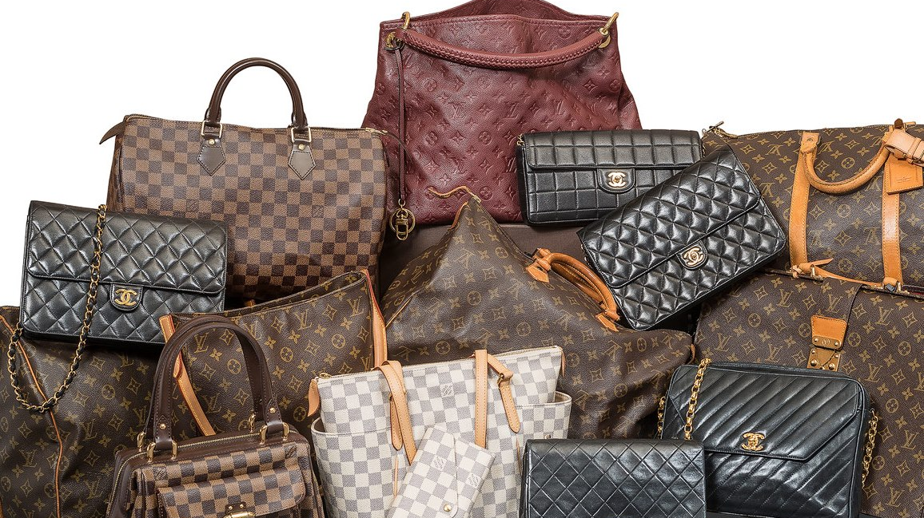
CHALLENGES
1) Less number of data
2) Variation in data across different brands
3) Some features were not available
Production type
Number of hours to manufacture
Source of skin
Launch year and season

Slide 20
THANK YOU

